Slide 2
Ant sorting
Menno Van Damme, Yari Van Laere

Slide 3

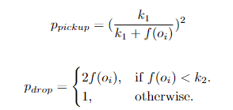
Lumer-faieta

Slide 4
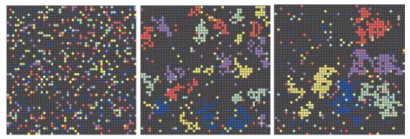
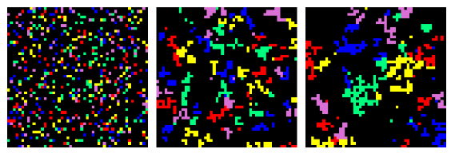
Results Lumer-Faieta

Slide 5
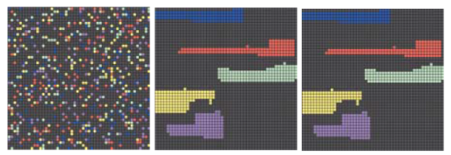

Results with clustering

Slide 6
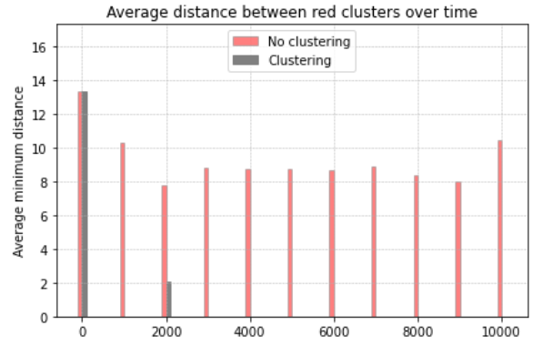
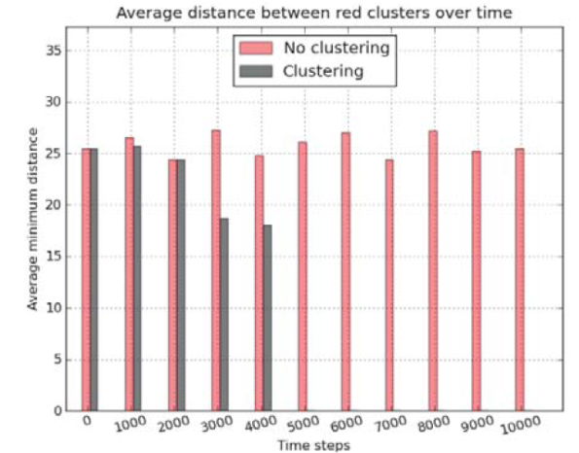
comparison

Slide 7
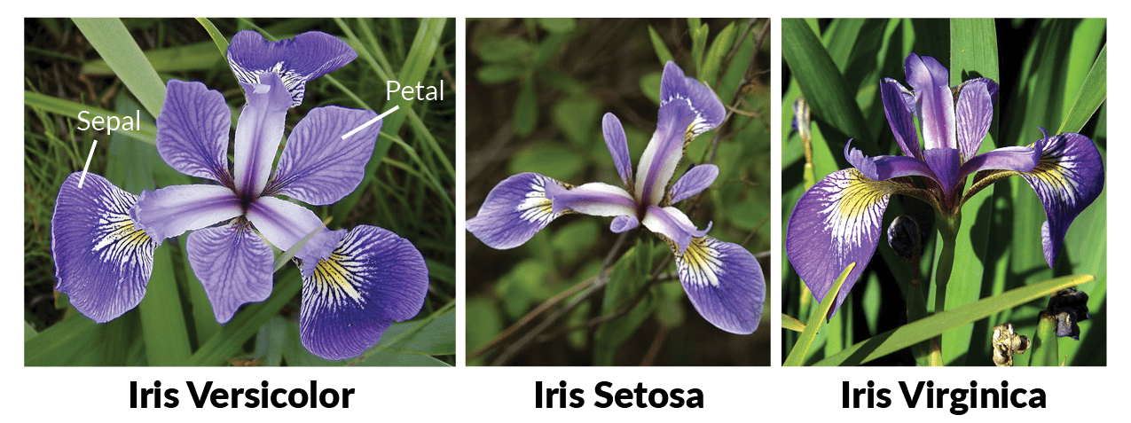
Continuous vector sorting

Slide 8
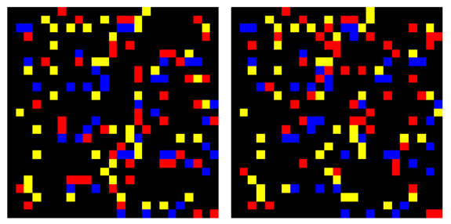
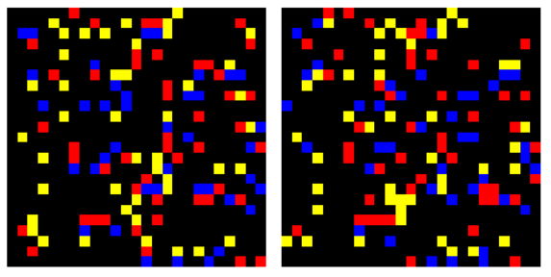
results
Lumer-Faieta without clustering
Lumer-Faieta with clustering

Slide 9
